Slide 1

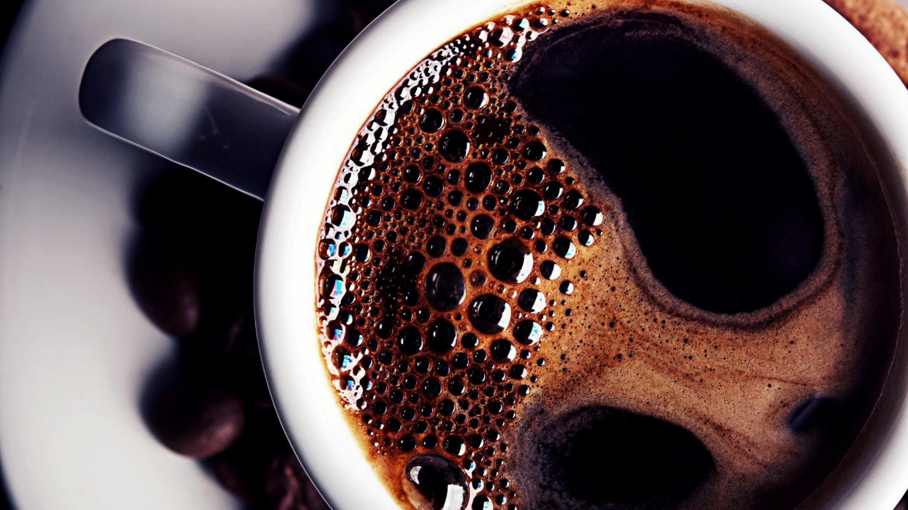
IoT-based Soil Moisture Monitoring System
IoT-based soil moisture monitoring system using the powerful ESP32 microcontroller.

Slide 2
Introduction to IoT
Interconnected World
The Internet of Things (IoT) connects physical objects to the internet, allowing them to exchange data.
01
Smart Applications
IoT applications encompass smart homes, agriculture, healthcare, and more.
02
Data-Driven Insights
Data collected from IoT devices provides valuable insights for informed decision-making.
03

Slide 3
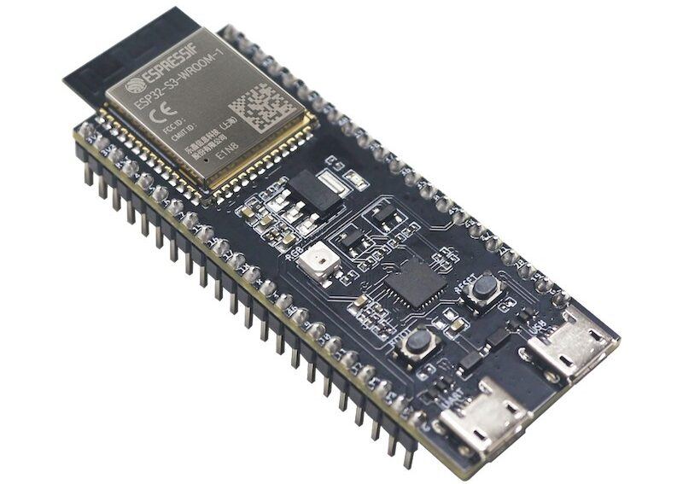
System Components
ESP32 Microcontroller
A powerful microcontroller with Wi-Fi and Bluetooth capabilities, responsible for data acquisition, processing, and transmission.

Slide 4
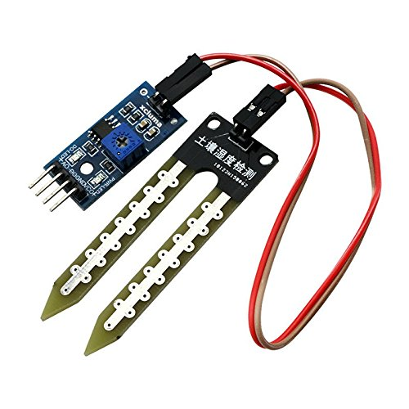
System Components
Soil Moisture Sensor
Measures the moisture level in the soil, providing real-time data to the microcontroller.

Slide 5
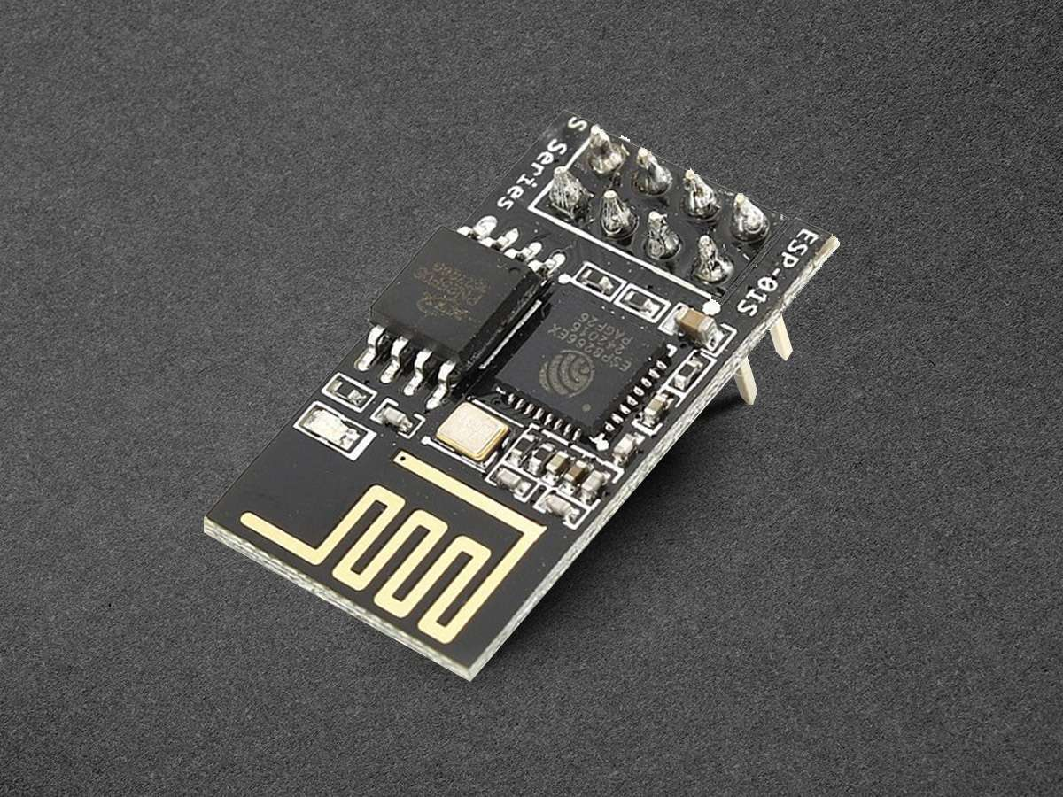
System Components
Wi-Fi Module
Enables wireless connectivity to the internet for data transmission to the cloud.

Slide 6
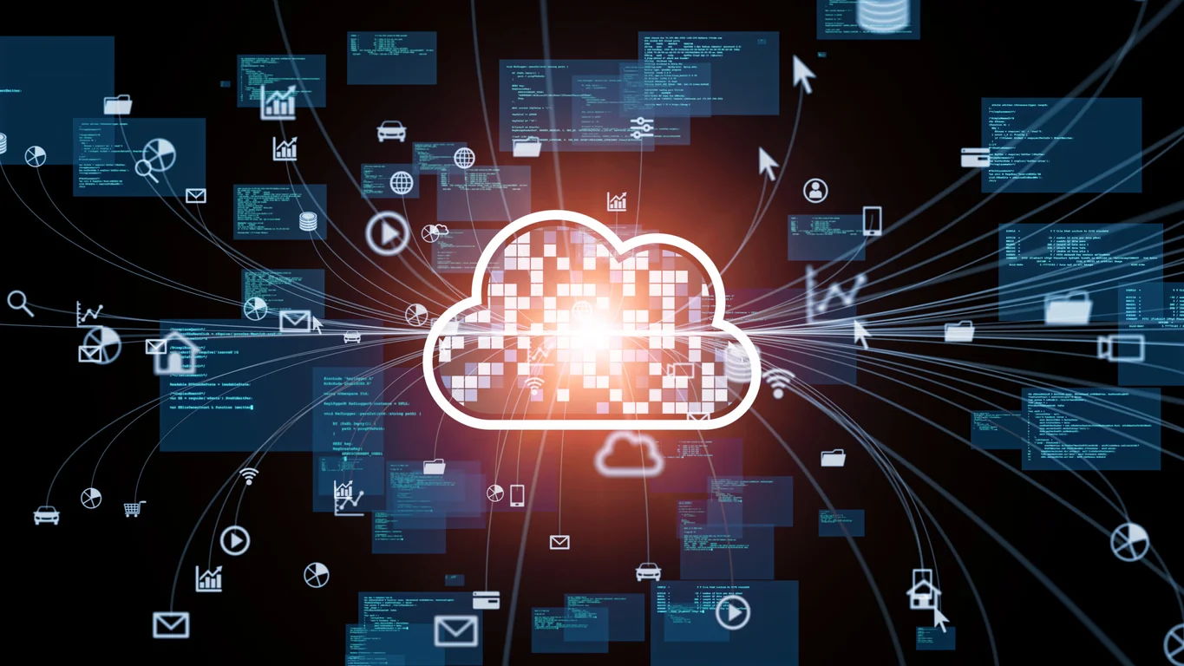
System Components
Cloud Platform
A secure server that stores and analyzes the data from the sensor, providing a central hub for data management.

Slide 7
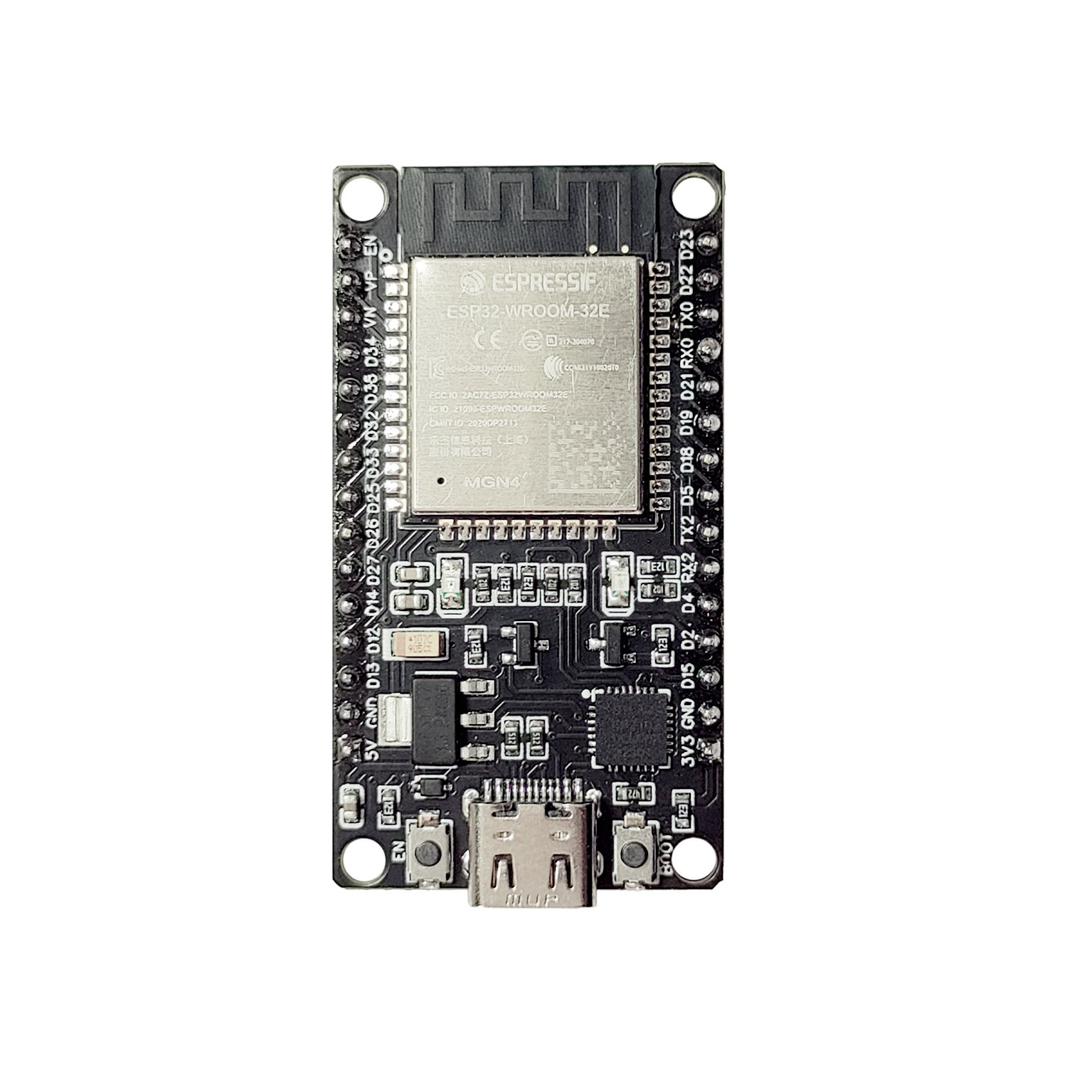
ESP32 Overview
Dual-Core Processor
Built-in Wi-Fi
Low Power Consumption
Rich Peripherals

Slide 8
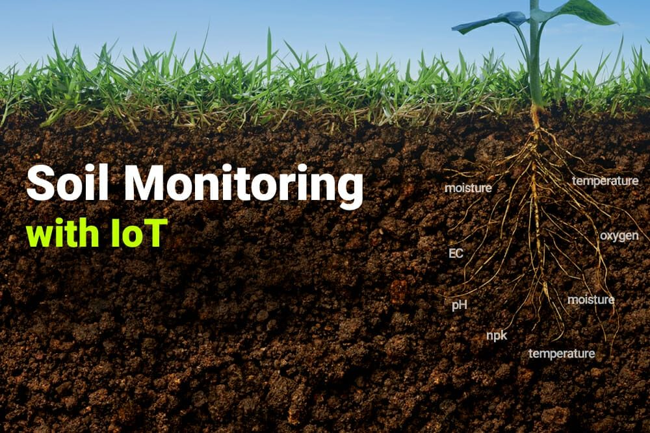
Soil Moisture Sensor Integration
Analog Signal
The sensor generates an analog signal proportional to soil moisture levels.
ADC Conversion
The ESP32's analog-to-digital converter (ADC) reads the sensor's analog signal.
Data Processing
The microcontroller processes the digital data to determine soil moisture levels.

Slide 9
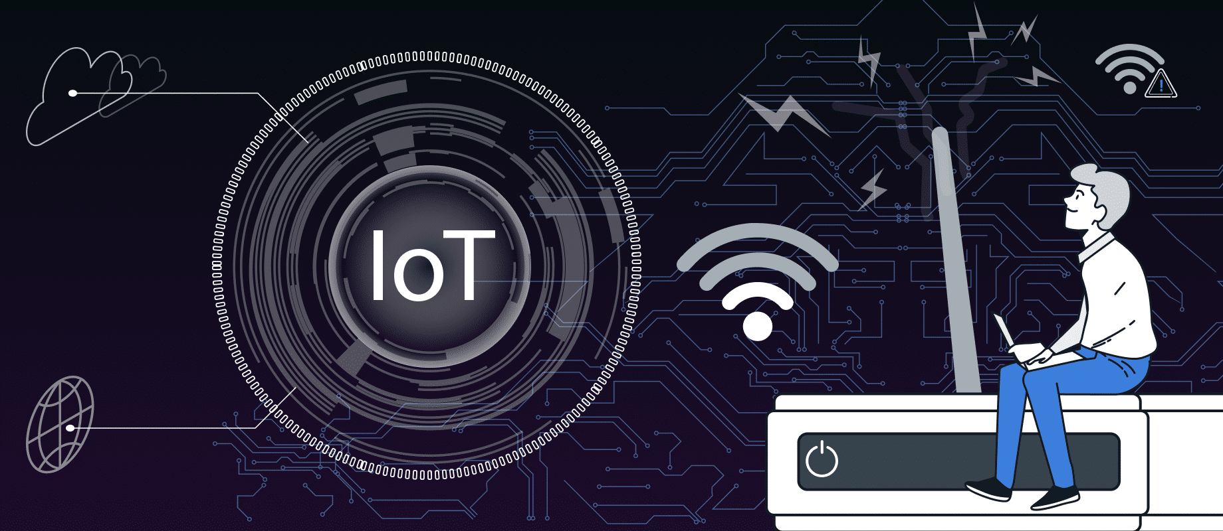
Data Transmission
Wi-Fi Connectivity
The ESP32 establishes a Wi-Fi connection to the internet.
Data Packaging
Soil moisture data is packaged into a specific format for transmission.
Cloud Upload
The ESP32 sends the data to the cloud platform for storage and analysis

Slide 10
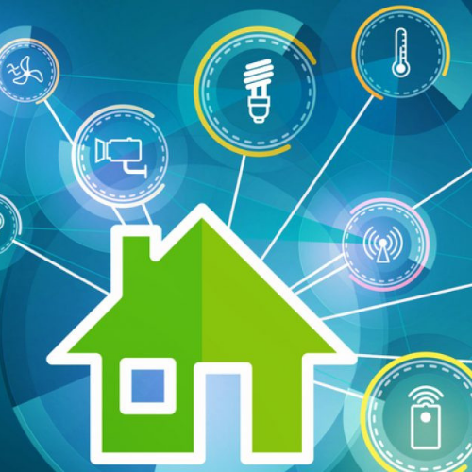
Power Management
Battery Optimization
Energy-saving techniques like deep sleep modes are implemented.
Power Management ICs
Power management ICs regulate power usage efficiently.
Solar Harvesting
Harvesting solar energy extends battery life and reduces environmental impact.

Slide 11
THANK YOU
Bindu y

